Slide 1
Donor Segmentation Strategies for University Acquisition Campaign
Applying the 80/20 Rule for Effective Donor Engagement
Eric Mack
6/1/2024

Slide 2
Introduction
We will outline our process and analysis of this historic giving data in the formation of a current market segmentation plan. This plan will be used to inform new campaign strategies for targeting new gift acquisitions.
We will import data into Power BI to create an interactive segmentation exploration tool.
Results from this exploration will in turn help to target donor pools and target ask numbers.

Slide 3
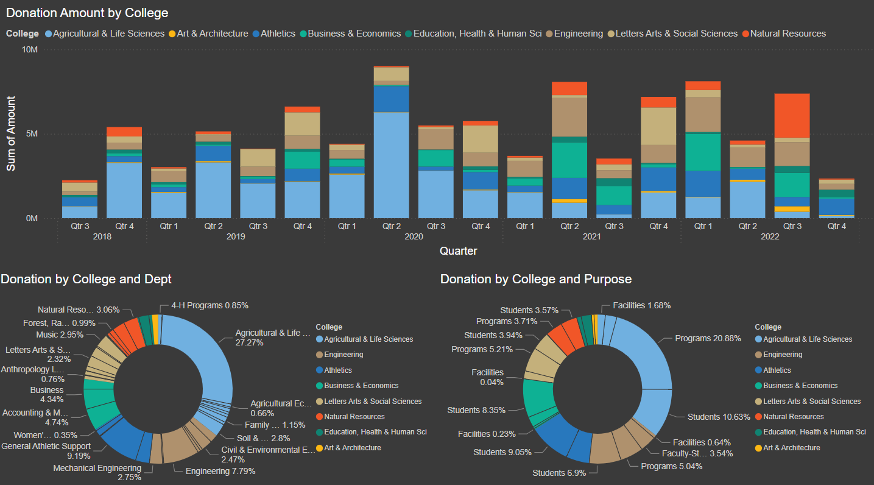

Slide 4
Data Overview
Project data comprised of three separate spreadsheets:
Spreadsheet 1: Contribution and segmentation data associated to a unique ID number referenced across all data sets
Spreadsheet 2: Contact information such as donor's name, address, and additional details
Spreadsheet 3: Partner relations data for generating friendly emails and resolving cross-referencing inconsistencies resulting from donations coming from one or the other spouse
Key fields available within the data set about the donation include: amount, and the designated College, Department, and Purpose of Gift
Key fields about the doners include: date and frequency of donation made, Donor Marital Status, Affiliation with College, and Association
Desired but unavailable data includes previous campaigns and their success with each client. Together with the cost of their outreaches, we would be able to compute ROI as well as better judge the likelihood of future success in gift acquisition.

Slide 5
Segmentation Strategy
Data Cleaning Before Merging:
Correcting duplicates in the names file.
Removing redundant fields from the data to enhance market segmentation.
Standardizing the primary ID column spacing across the three spreadsheets to ensure consistency for successful merging.
Observe deceased donor patterns, but then remove from the pool.
We will apply the 80/20 rule and segment the data by net amount of donation in sliced subcategories.

Slide 6
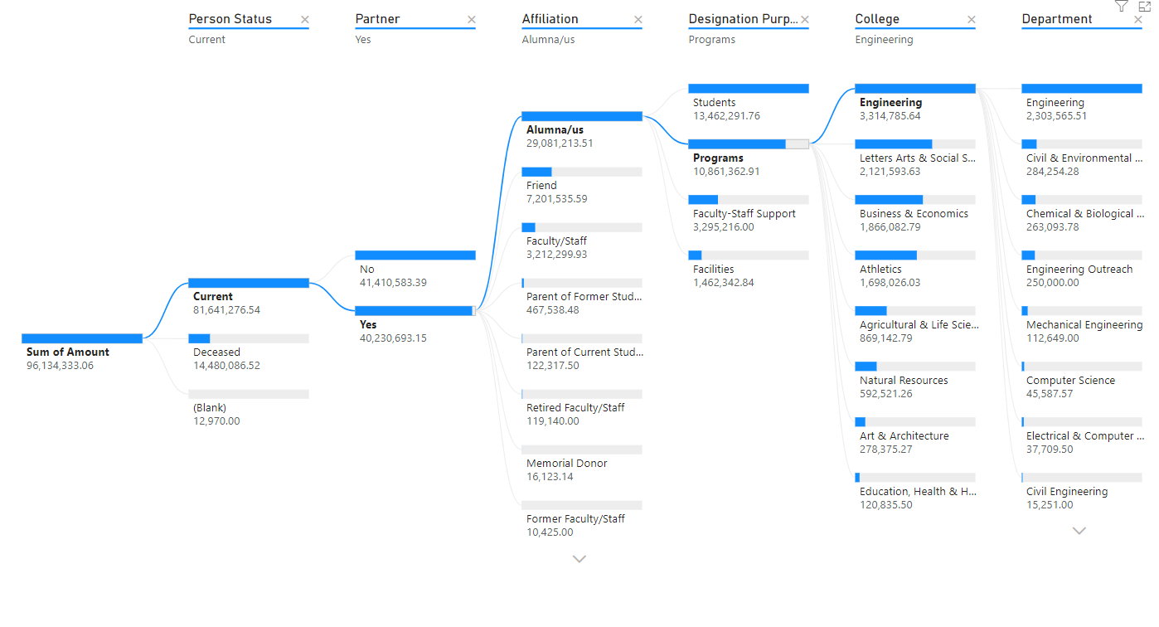
Segmentation Variables
We will use a tree diagram to branch the total donations by Person status, Partner status, Affiliation, Purpose, College, and finally Department providing a useful way to see where the most donations were going. Ordering was chosen to minimize number of nodes in early splits.

Slide 7
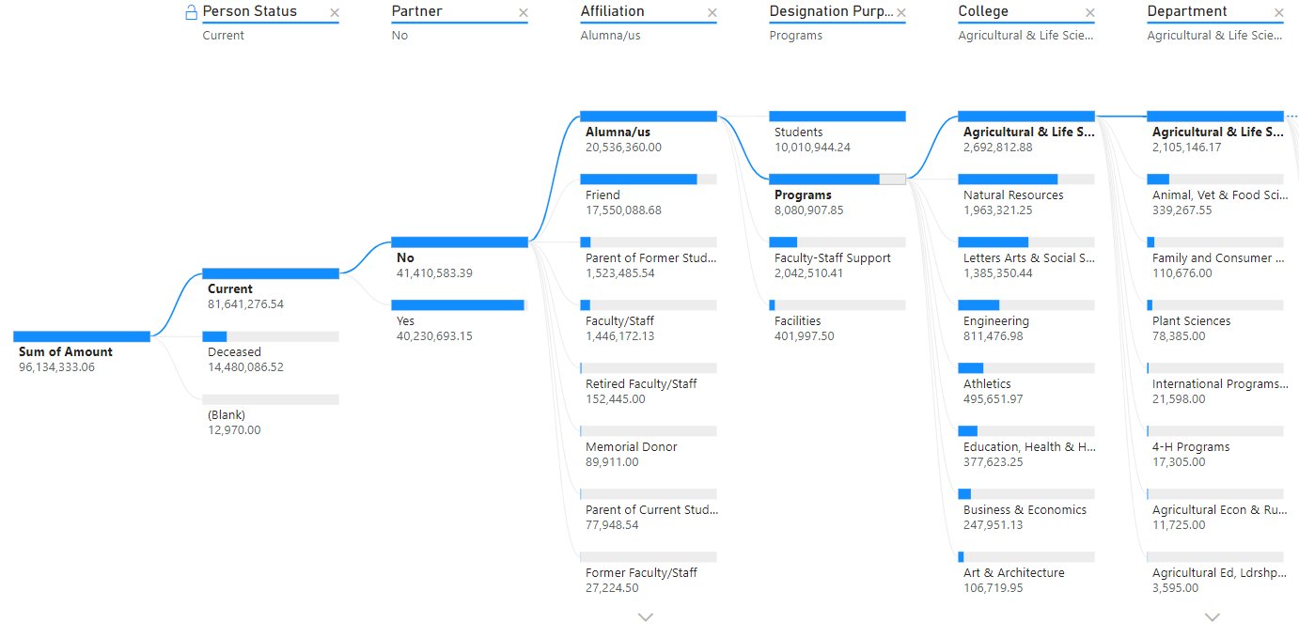
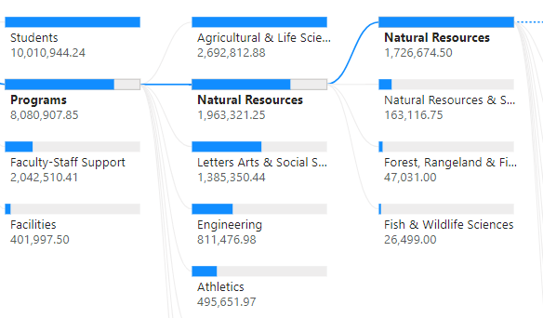
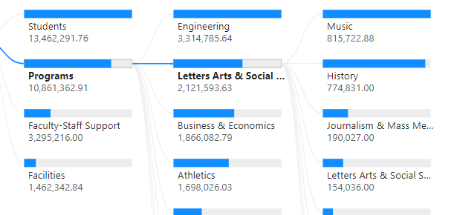
Program level Observations of living Alumni
Single
Partnered

Slide 8
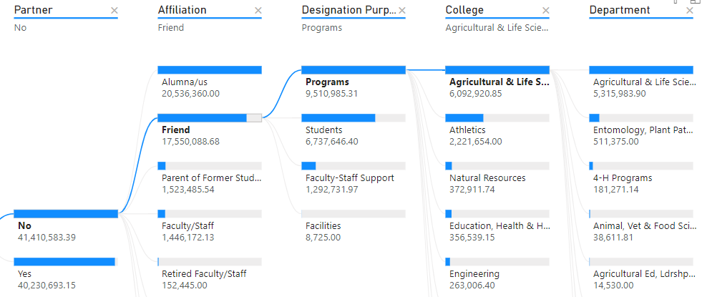
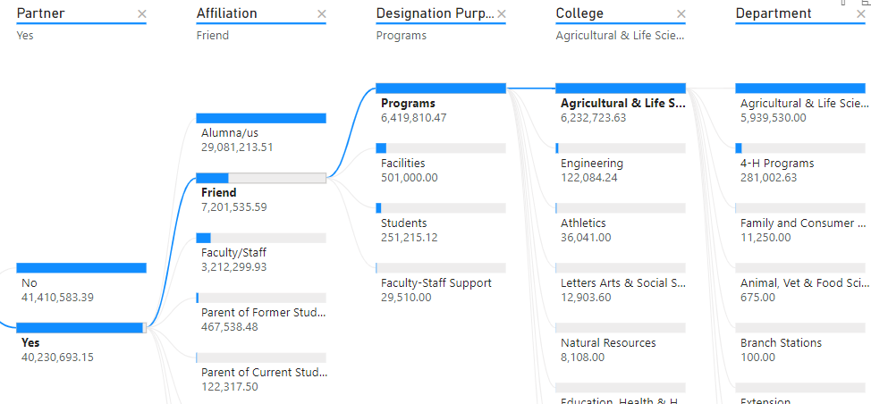
Program level Observations of living Friends of the university
Overall support is consistently given to Ag and Life Sciences regardless of partner status.

Slide 9
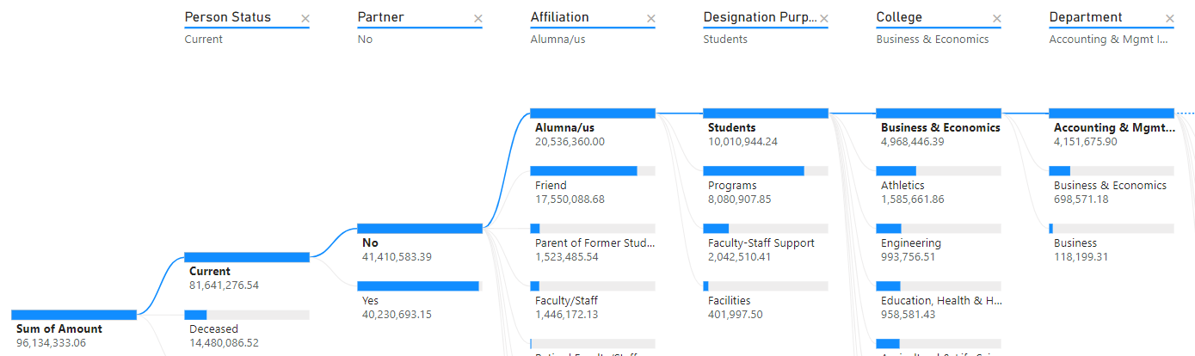
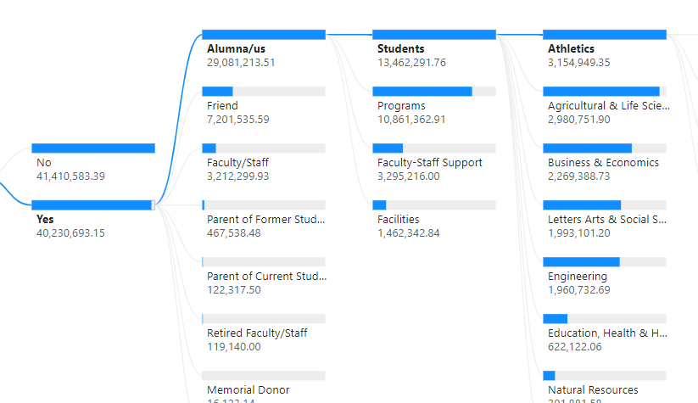
Observations on alumni giving to students
Single
Partnered
Note the narrow vs. wide college variation split on partner status

Slide 10
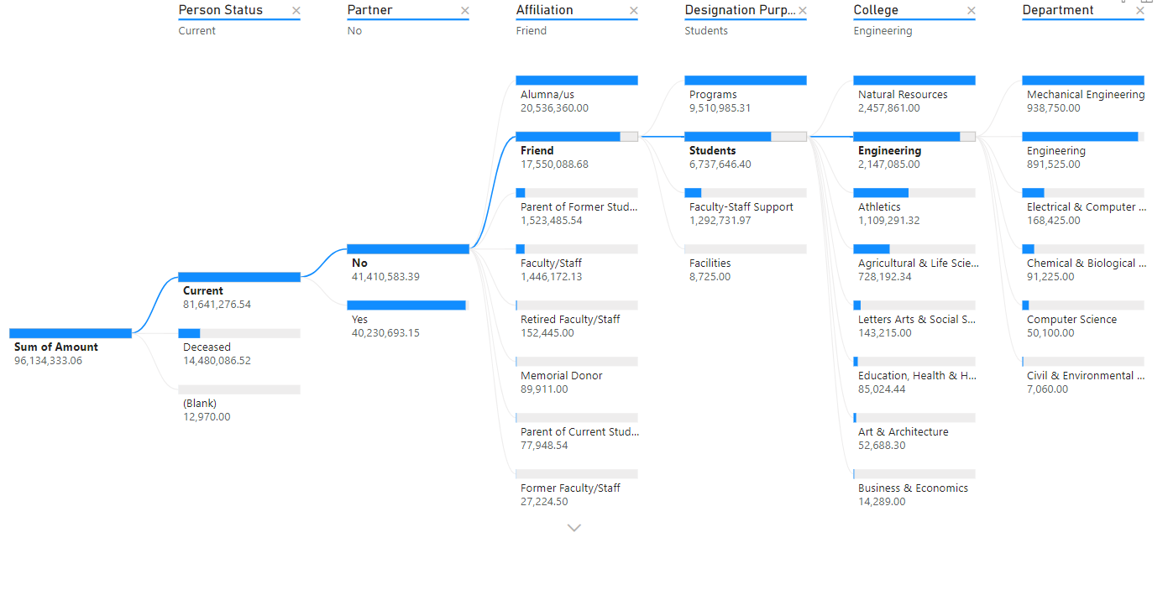
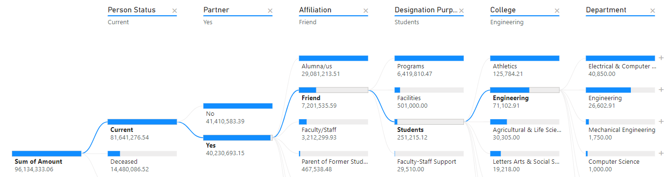
gifts directed to students by friends of the university
Single
Single and married donors support Engineering, but single donors favor Natural Resources while partnered donors favor Athletics (Note: student support in general is much lower for partnered Friends.)
Partnered

Slide 11
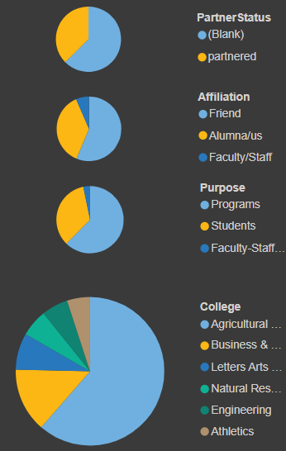
Key Features of Major Donors
Most live in ID, most are alumni or friends
Directed to Ag/ Life Sci and Business colleges
More single than partnered
Very large one-time donations come more often from single Friends of the college
Average donation amounts > $1m

Slide 12
Key Features of Major Donors
First Name | Last Name | Partner status | College | Affiliation | Total Amount | # of Gifts
Jacqueline | Cooley | partnered | Agricultural & Life Sciences | Friend | 6,547,000 | 11
Mary | Colt | partnered | Agricultural & Life Sciences | Friend | 5,300,000 | 1
Brianna | Hudson |  | Business & Economics | Alumna/us | 4,201,823 | 18
Nigel | Horne |  | Agricultural & Life Sciences | Alumna/us | 3,210,720 | 3
Jabari | Molly |  | Natural Resources | Friend | 2,396,500 | 7
Cheyenne | Theodore |  | Agricultural & Life Sciences | Faculty/Staff | 2,369,055 | 8
Nathanial | Santana | partnered | Business & Economics | Alumna/us | 2,365,000 | 9
Dereon | Powers |  | Business & Economics | Friend | 2,315,000 | 6
Niko | Ramsey | partnered | Letters Arts & Social Sciences | Friend | 2,050,050 | 10

Slide 13
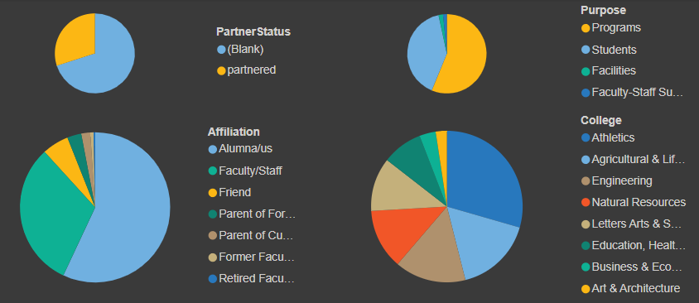
Key Features of Loyal Donors
(charts show freq of giving not amount)
Most live in ID
Made up mostly Alumni and Faculty/Staff
Directed to Engineering and Athletics
More single than partnered
Donations are modest but regular (monthly or more freq. is common)

Slide 14
Key Features of Loyal Donors
First Name | Last Name | State | College | Affiliation | Total Amount | # Of Gifts
Grace | Pace | ID | Engineering | Alumna/us | 11,545 | 316
Stephen | Montoya | ID | Agricultural & Life Sciences | Faculty/Staff | 1,205 | 231
Lauren | Kent | ID | Education, Health & Human Sci | Alumna/us | 1,770 | 231
Melina | Gutierrez | ID | Agricultural & Life Sciences | Faculty/Staff | 20,457 | 192
Zachary | Bright | ID | Letters Arts & Social Sciences | Alumna/us | 880 | 170
Yasmine | Brewer | ID | Agricultural & Life Sciences | Faculty/Staff | 3,843 | 132
Zion | Addison | ID | Art & Architecture | Faculty/Staff | 48,938 | 130
Keyon | Lara | ID | Engineering | Alumna/us | 5,665 | 125
Zion | Stephanie | ID | Athletics | Alumna/us | 1,134 | 119
Yasmine | Alexander | ID | Athletics | Alumna/us | 4,768 | 118

Slide 15
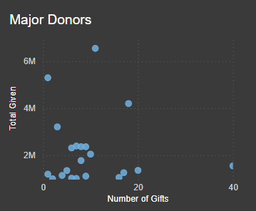
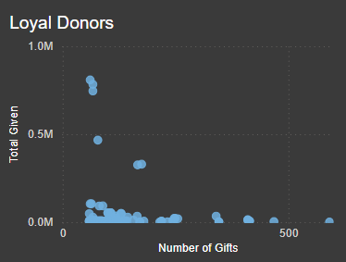
Campaign Strategies
Cross reference with tree sort diagram to target college and purpose.
Major Donors
Personalized outreach and recognition
Tailored proposals for large gifts
Loyal Donors
Regular updates and engagement
Matching gift opportunities
One-time top Donors
Specific campaign appeals
Highlighting impact of past donations

Slide 16
Engagement Tactics
Major Donors: Exclusive events, personalized letters
Loyal Donors: Newsletters, impact reports
One-time Large Donors: Targeted campaigns, project updates

Slide 17
Summary of Recommendations
Prioritize segments with highest potential (Major and Loyal Donors)
Develop tailored communication strategies for each segment
Use data to refine and adjust strategies over time (slice out deceased and one-time donors to get a more accurate sense of normal flow and trends)

Slide 18
Conclusion
Importance of targeted donor engagement: It is important to make the right kinds and sizes of ask. To do this we need to know our audience.
There are a few very large one-time donations. While these are amazing and should be courted the data does not suggest these should be included in our segmentation for seeking recurring gifts.
Our biggest givers consistanly target Ag/ Life Sciences, Business, and Engineering.
Single donors also favor Natural Resources.
Partnered alumni donors also favor Athletics and Music.

Slide 19

Q&A

